Slide 1
Employee Data Analysis using Excel
STUDENT NAME: MERLIN JOSPHINE D
REGISTER NO: 2213371036221
NM ID: C49D5A3F0D39A99802F4647AE4DCBFE3
DEPARTMENT: BACHELOR OF COMMERCE
COLLEGE: QUAID - E - MILLETH GOVERNMENT COLLEGE FOR WOMEN(AUTONOMOUS)

Slide 2
PROJECT TITLE
Employee Performance Analysis using Excel

Slide 3
AGENDA
Problem Statement
Project Overview
End Users
Our Solution and Proposition
Dataset Description
Modelling Approach
Results and Discussion
Conclusion

Slide 4
PROBLEM STATEMENT
We aim to analyze employee performance data using Excel to identify key factors that influence productivity. This analysis will help us uncover trends, recognize high performers, and make informed decisions on training and promotions. The insights gained will guide our efforts to enhance overall workforce efficiency.

Slide 5
PROJECT OVERVIEW
This project analyzes employee performance by examining factors like gender, performance scores, ratings, and achievements. The goal is to identify trends and patterns among different employee categories, such as high, medium, and low performers. This analysis will help in understanding the factors that contribute to varying levels of performance.

Slide 6
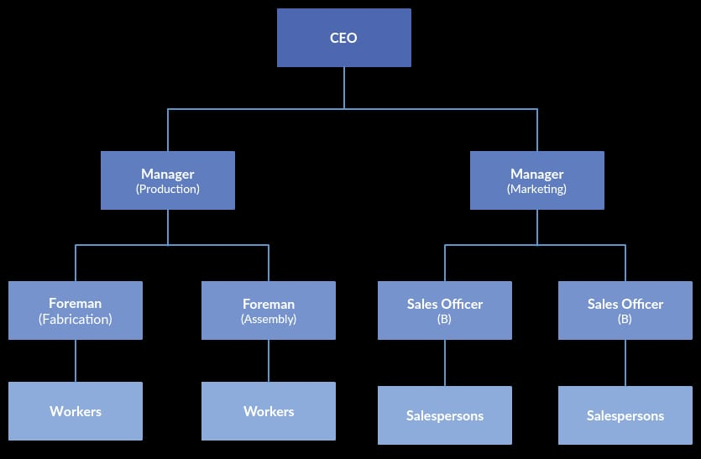
WHO ARE THE END USERS?

Slide 7
OUR SOLUTION AND ITS VALUE PROPOSITION
Our solution uses Excel's conditional formatting to easily identify and highlight missing values, with filters to remove incomplete data for cleaner analysis. We apply formulas to calculate each employee's performance level and use pivot tables to summarize the findings. Finally, we create graphs for clear data visualization, enabling better decision-making and insights into employee performance trends.

Slide 8
Dataset Description
Employee Information: Includes fields like EmpID, FirstName, LastName, and ADEmail.
Employment Details: Covers the StartDate, ExitDate, Title, Supervisor, BusinessUnit, EmployeeStatus, EmployeeType, and PayZone.
Demographics: Includes DOB, State, GenderCode, RaceDesc, MaritalDesc, and LocationCode.
Performance: Contains Performance Score, Current Employee Rating, TerminationType, TerminationDescription, and DepartmentType.

Slide 9
THE "WOW" IN OUR SOLUTION
The "WOW" in our solution is the use of a simple formula to calculate employee performance levels:
Performance Level = Performance Score + Current Employee Rating
This formula combines both qualitative and quantitative measures, making it easy to assess and visualize overall employee performance.

Slide 10
MODELLING
Data Collection: Retrieved the employee dataset from Kaggle.
Data Cleaning: Used Excel functions and conditional formatting to identify and handle missing values.
Data Preprocessing: Converted qualitative data into numerical form and calculated the Performance Level using a custom formula.
Filtering: Removed records with missing values to ensure clean data for analysis.
Analysis: Used Excel formulas to calculate key metrics like average ratings and performance scores.
Pivot Table: Created pivot tables to summarize and categorize data by factors like department, gender, and performance levels.
Visualization: Used Excel charts and graphs to visualize trends and patterns in employee performance.

Slide 11
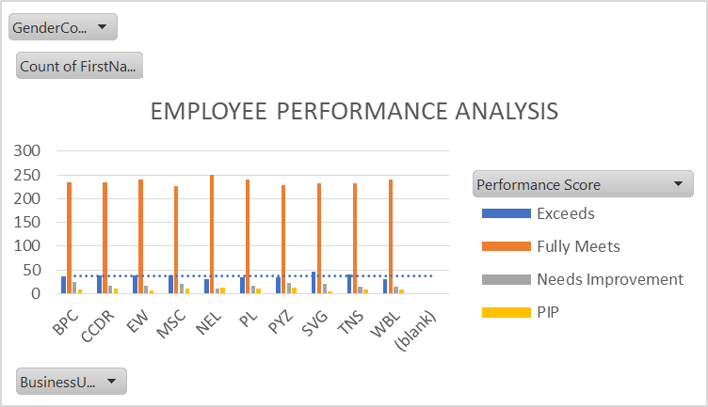
RESULTS

Slide 12
Conclusion
The Employee Performance Analysis chart indicates that the majority of employees in each business unit are performing at the "Fully Meets" level. However, there are also a significant number of employees performing at the "Exceeds" level, suggesting strong overall performance. While some employees are "Needs Improvement," the overall distribution is positive. The specific breakdown of performance levels varies across business units, highlighting potential areas for targeted development or recognition.

